Slide 1
PhySol: Machine Solver for Textually Represented Physics Problem Implementing RNN-based Information Extraction
BESABE, Lester Y. and CAMERO, Jan Andrew S.

Slide 2
To evaluate and solve Physics word problems.

Slide 3
Computational word problems involve a lot more than just solving calculations.
Computer still lacks an algorithm that can fully solve computational problems that are described in the natural language. (Shi et al., 2015)
As for machines, information that is represented by the natural language are considered as data in an unstructured form.

Slide 4
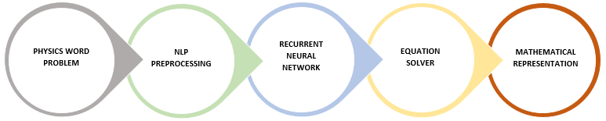
Theoretical Framework

Slide 5
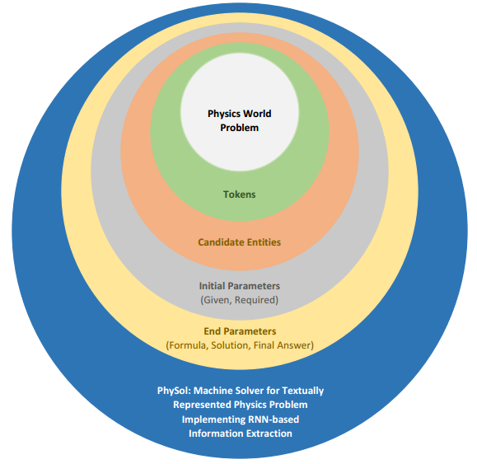
Conceptual Framework

Slide 6
The study aims to translate a Physics word problem into its corresponding numerical representation. As well as to extract important parameters in the given problem using RNN-based Information Extraction. Specifically, this study seeks to answer the following questions.
1.) What is the level of accuracy of the system in implementing RNN-based Information Extraction in Physics word problem. In terms of the following parameters:
Given
Required
2.) What is the level of accuracy of the system in evaluating and solving the given Physics word problem. In terms of the following parameters:
Formula
Final Answer

Slide 7
Scope and Limitation
Electricity
Voltage
Current
Resistance
Power
Forces
Newton’s Law of Motion
Motions (Kinematics)
Speed
Velocity
Acceleration

Slide 8
Scope and Limitation
Physics word problem should only have not more than one (1) explicit Required.
Incorrect spelling of parameters and keywords can be accepted by the system, considering that the consistency of the incorrectness is observed.
All input should be grammatically correct.

Slide 9
Related Literature and Study
Title | Author
Machine Solver for Physics Word Problems | Leszczynski & Moneira, 2017
Natural Language Processing for Solving Simple Word Problems | Sundaram & Khemani, 2015
Reading Coaching for Math Word Problems | Edwards, Waloy, & Anderson, 2009
GWPS: Geometry Word Problem Solver | Apostol & Orsolino, 2016
Making Sense of Word Problems | Verschaffel, Greer, & de Corte, 2000

Slide 10
Strengths | Weaknesses
Symbolic Approach: Accurate when domain specific grammar is implemented. Statistical Approach: Flexible in semantic analysis. | Symbolic Approach: Inputs should comply with the grammar. Statistical Approach: Vast domain often produces ambiguous result. Grammar: The design of grammar is domain specific.
Opportunities | Threats
Approach: Method implementing both Symbolic and Statistical Approach Grammar: Dynamically-designed grammar | Input: Noise parameters can make the machine learning ambiguous. Approach: The design of the grammar to be used entirely depends on the data set. RNNs are black box once they are trained, thus, a difficulty in tuning and interpreting the model will be observed

Slide 11
Research Design
Experimental Research Design: After-Only without Control design
Variables
Independent Variables: Physics Word Problem
Dependent Variables: Overall Parameters (Given, Required, Formula, Solution, Answer)
Test Area
Dynamic Grammar Model

Slide 12
Sources of Data
Published textbooks (e.g. Elementary Physics or High School Level Physics)
Probabilistic Sampling Technique: Stratified Random Sampling
Heterogenous population of 500 Physics word problems

Slide 13
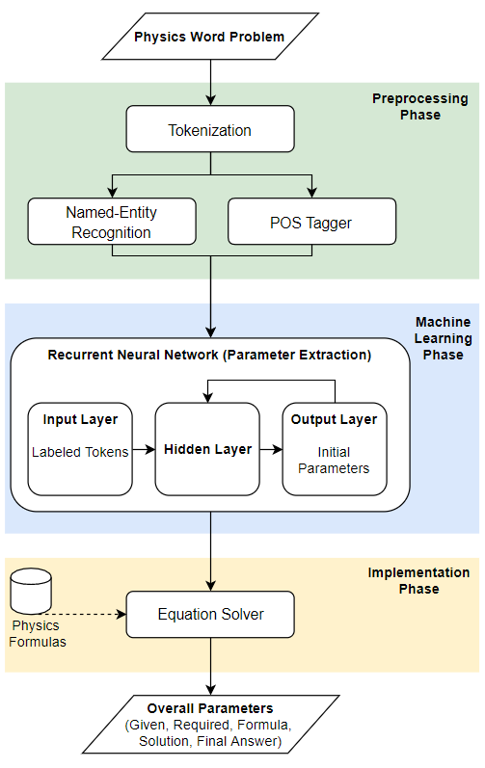
System Architecture

Slide 14
“Jairus walks at a speed of 4 kmph, while his friend, Edil, walks at a speed of 6 kmph. How much time does Jairus will take to walk a distance of 20 km?”

Slide 15

“Jairus walks at a speed of 4 kmph, while his friend, Edil, walks at a speed of 6 kmph. How much time does Jairus will take to walk a distance of 20 km”
Given: 4 kmph (Speed of Jairus), 20 km (distance)
Required: Time
Formula: Time = $\frac{Distance}{Speed}$
Solution:
Time = $\frac{Distance}{Speed}$
Time = $\frac{20 km}{4 kmph}$
Time = $5 hours$

Slide 16
Development Details
Programming Language
Java
IDE
Eclipse
Database
MySQL
Toolkits
POS Tagger
Name-Entity Recognition
TensorFlowTM

Slide 17
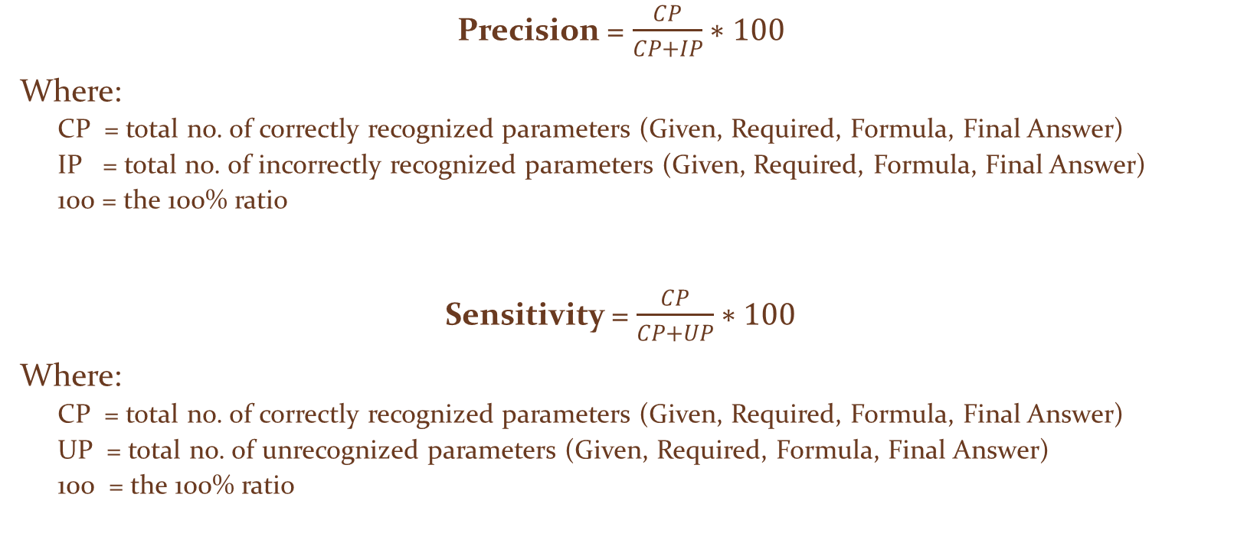
Statistical Data Analysis
Precision = $\frac{CP}{CP+IP}∗100$
Where:
CP = total no. of correctly recognized parameters (Given, Required, Formula, Final Answer)
IP = total no. of incorrectly recognized parameters (Given, Required, Formula, Final Answer)
100 = the 100% ratio
Sensitivity = $\frac{CP}{CP+UP}∗100$
Where:
CP = total no. of correctly recognized parameters (Given, Required, Formula, Final Answer)
UP = total no. of unrecognized parameters (Given, Required, Formula, Final Answer)
100 = the 100% ratio

Slide 18

Statistical Data Analysis
Error Rate = $\frac{TP−IP}{TP}∗100$
Where:
TP = total no. of parameters (Given, Required, Formula, Final Answer) to be recognized
IP = total no. of incorrectly recognized parameters (Given, Required, Formula, Final Answer)
100 = the 100% ratio

Slide 19

Statistical Data Analysis
Overall Precision = $\frac{P1+P2+...+Px}{x}∗100$
Where:
x = Total Number of Physics Word Problem
P₁ = Precision of Physics Word Problem 1
P₂ = Precision of Physics Word Problem 2
…
P_{x} = Precision of Physics Word Problem x

Slide 20

Statistical Data Analysis
Overall Sensitivity = $\frac{S1+S2+...+Sx}{x}∗100$
Where:
x = Total Number of Physics Word Problem
S₁ = Sensitivity of Physics Word Problem 1
S₂ = Sensitivity of Physics Word Problem 2
…
S_{x} = Sensitivity of Physics Word Problem x

Slide 21

Statistical Data Analysis
Overall Error Rate = $\frac{E1+E2+...+Ex}{x}∗100$
Where:
x = Total Number of Physics Word Problem
E₁ = Error Rate of Physics Word Problem 1
E₂ = Error Rate of Physics Word Problem 2
…
E_{x} = Error Rate of Physics Word Problem x

Slide 22
Thank you.

